Slide 1


Informing Fisheries Management with Individual-Based Models in R: Design, Implementation, and Analysis

Slide 2
Structure of workshop
1:00-2:00: Introduction / Overview / Lecture
2:00-2:15: Break
2:15-3:30: Build a basic model as a group
3:30-3:45: Break
3:45-5:00: Start building your own model

Slide 3
Introductions
Name
Position
Place of employment
Why are you interested in IBMs? What questions would you like to answer with an IBM?
Proficiency in R (1 = “what is R?”; 5 = pro)
What is your favorite fish species?

Slide 4
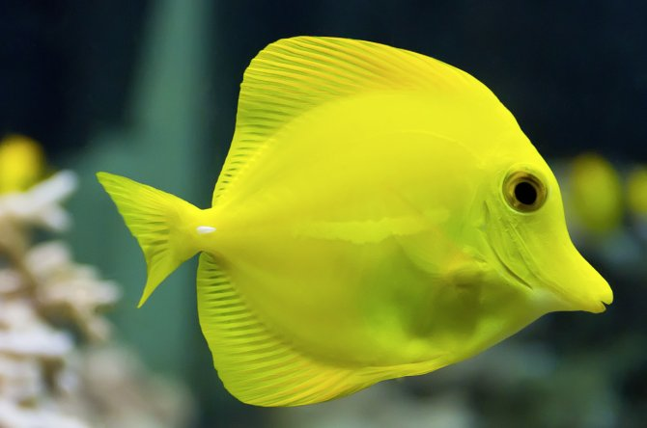
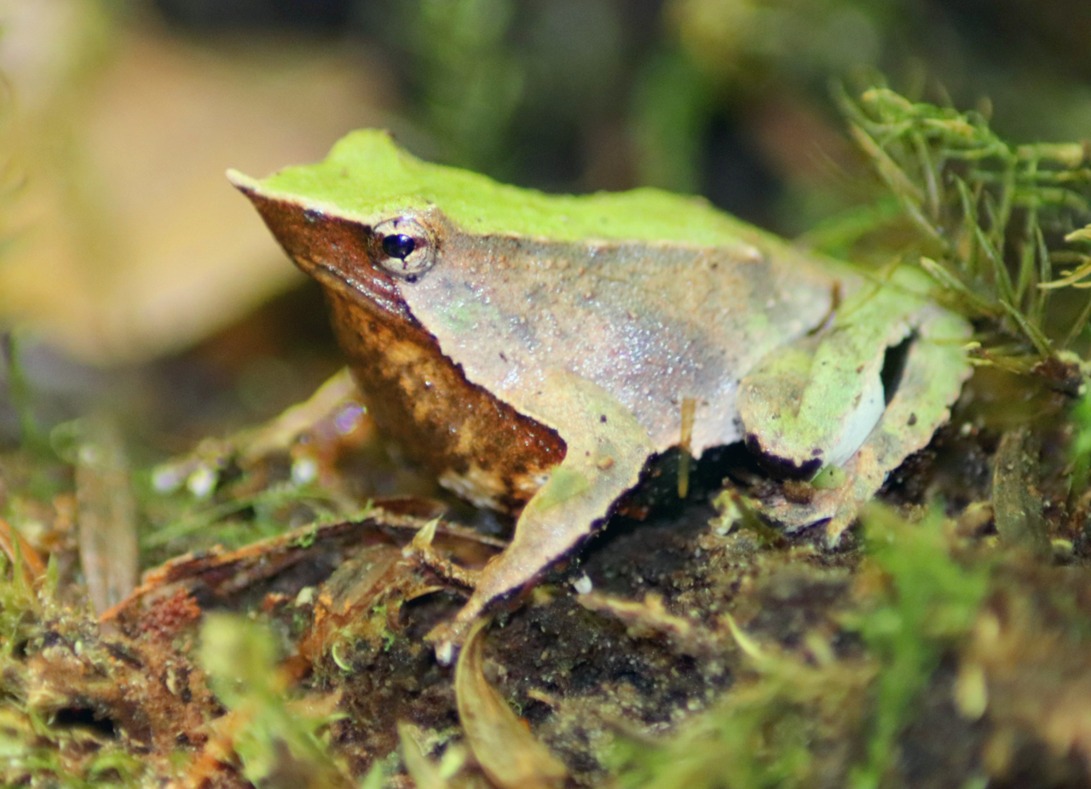
About us
Mark Christie
Associate Professor
Rapid evolution
Catherine Searle
Associate Professor
Disease Ecology

Slide 5
Agent Based Models

Slide 6
Nomenclature
Individual based models (IBMs)
Most often used in ecology & evolution
By definition requires “individuals”
Agent based models (ABMs)
More general term
Individuals are one type of agent
Used more broadly

Slide 7
What is an agent?
Any entity that can be acted upon in a computational environment and that typically represents something in the real world
Examples:
individuals
fish
genes
genomes
cells
viruses/pathogens
species
companies / military troops / asteroids etc.

Slide 8
What is an ABM?
Any computational model that applies a specific set of processes (e.g., functions) to agents, often iteratively.
Often allows for interactions among agents
Can be thought of as a type of simulation
Every individual is accounted for (typically)
No equations (“math”) are needed (but can be very useful)
Typically progresses in a series of discrete steps (growth, reproduction death)

Slide 9
Mathematical models (a comparison)
“Mathematical modeling is the process of using mathematical concepts and language to represent a real-world system. The goal of mathematical modeling is to understand the system and to make predictions about its behavior.
A mathematical model is an abstract description of a concrete system. It is not the system itself, but rather a simplified representation of it. The model is created by identifying the important features of the system and then representing them mathematically.”

Slide 10
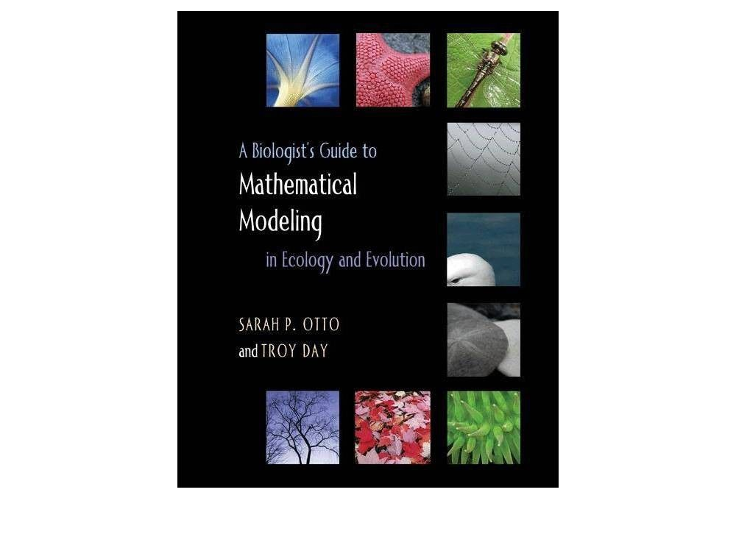
Mathematical models (a comparison)

Slide 11
Advantages of ABMs
Can be as simple or complex as you like
Can incorporate biological complexity that would be otherwise mathematically intractable
Can handle large numbers of parameters
Deal well with complex systems
Can be customized to any system
Can be parameterized with real data
Deal well with stochastic systems

Slide 12
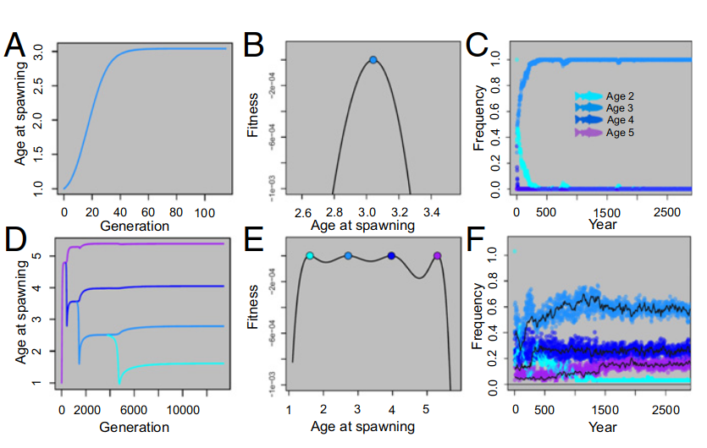
Advantages of ABMs
Can complement empirical data
Can complement mathematical models

Slide 13
Advantages of ABMs
Can complement empirical data
Can be used to make predictions
Can be used to assist with management decisions
Are fully reproducible
Can be used as a tool for others to use
Can be tweaked to answer subsequent questions
Can have multiple type of agents operating at multiple levels (e.g., genes, genomes, individuals)
Are fun!!

Slide 14
Disadvantages of ABMs
Require careful and rigorous coding practices
Can be difficult to understand or re-use or transfer (e.g., R vs. C++ vs. no coding knowledge) [contrasts with equations from mathematical modeling]
Communication
Can be memory intensive
Can be slow (both to develop and to run)
Nefarious bugs possible
Subject to academic snobbery

Slide 15
When is it a bad idea to use an ABM?
You do not enjoy coding or the idea of coding (be careful with this though)
You can intuitively determine the answer to your question (i.e., you can predict what the model output will be even before you run the model)
Examples:
Will a novel disease reduce adult abundance?
Will an invasive species be able to invade open habitat?

Slide 16
When is it a bad idea to use an ABM?
You want to build a model to “prove” something
Be aware that anyone can build an ABM or a mathematical model that shows whatever they want (very important to remove your preconceived notions and do not let those bias you during model construction).

Slide 17
When is it a good idea to use an ABM?
You are working in a complex system with many parameters
You cannot a priori determine the answer to your questions
You are open to answers being different from your predictions
You are interested in the dynamics of the system (e.g., mechanisms, behavior, interactions, complexity).

Slide 18
Model complexity
Strike a balance between simplicity and complexity
When possible, err towards simplicity
Too complex: every hour and every day of a long-lived species is modeled
Too simple: no parameters can be varied

Slide 19
Questions first!
Write down and refine questions over several days
Good to have one over-arching question and several sub-questions
Begin thinking about key parameters and model steps

Slide 20
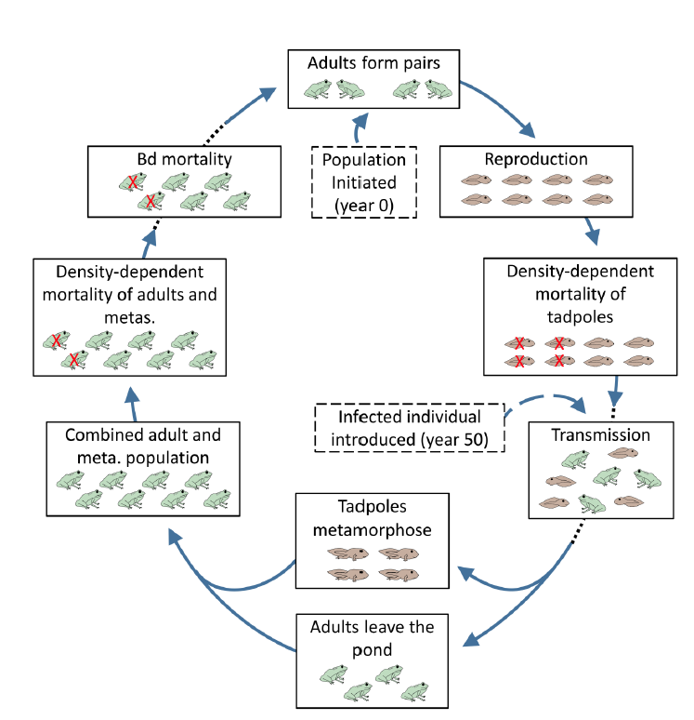
Always draw out model first
Christie and Searle 2018

Slide 21
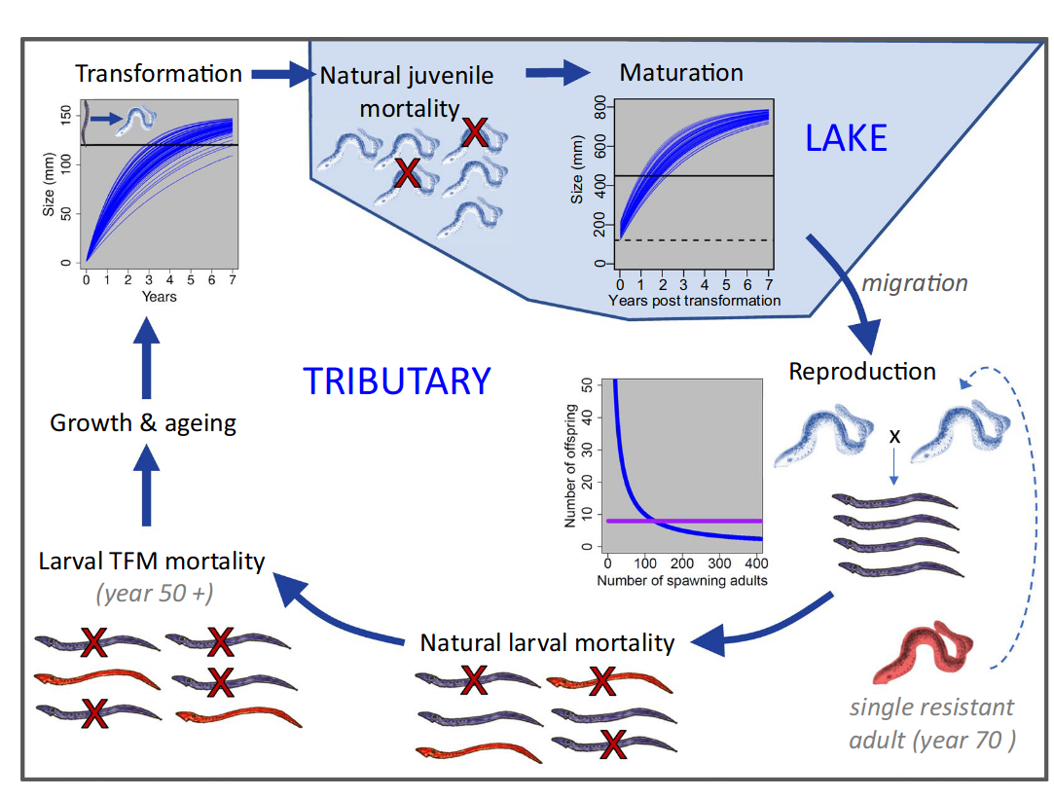
Always draw out model first
Christie et al. 2019

Slide 22

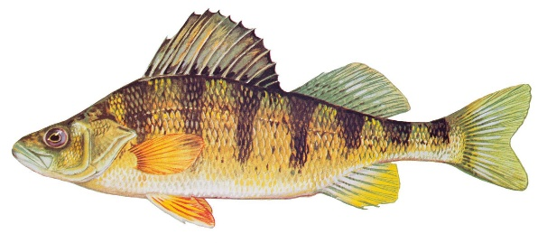
Workshop ABM
Ageing
Fishing
Stageing
Adult mortality
Juvenile mortality
Adult pairs form
Reproduction

Slide 23
Basic structure of ABMs
Create agents
Create identifying information
Create parameters
Create data frames, matrices, and lists
Create functions/flow
Create output

Slide 24
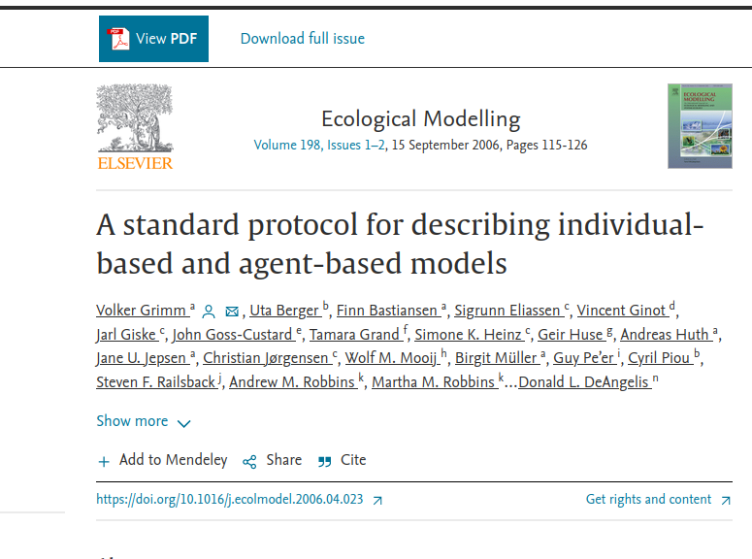
ODD concept

Slide 25
Functions versus equations
Mathematical models use equations
ABMs should use a series of discrete functions

Slide 26
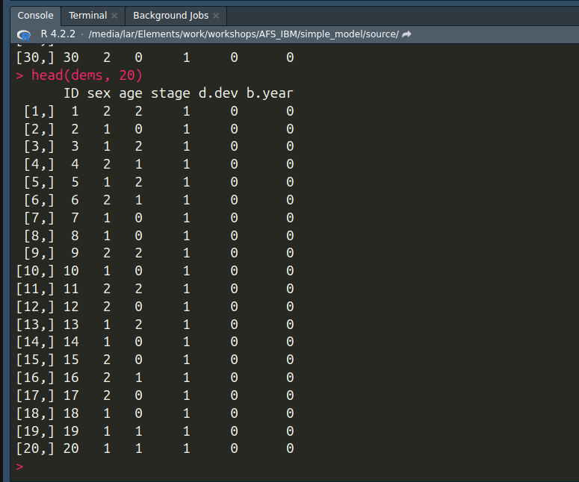
Create agents

Slide 27
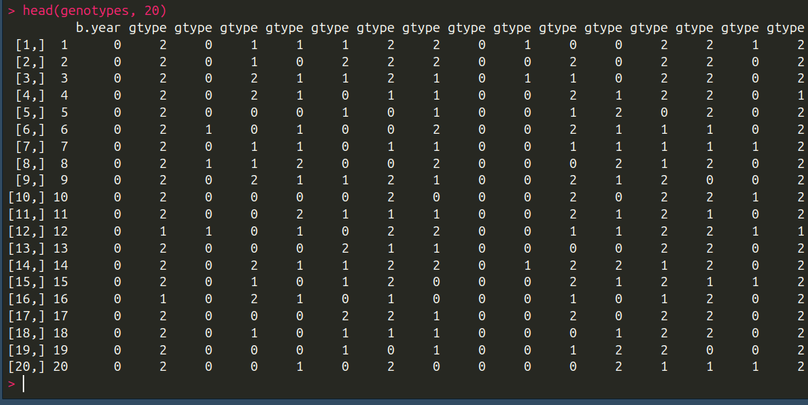
Create agents

Slide 28
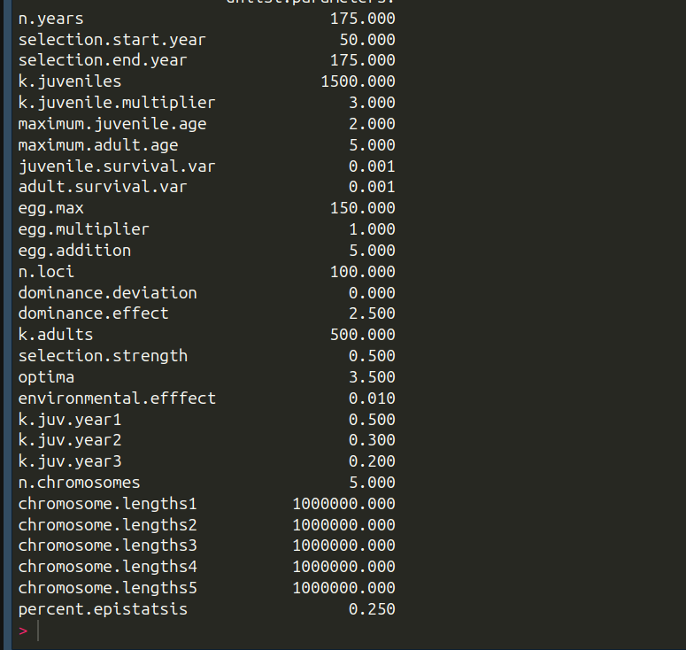
Create parameters

Slide 29
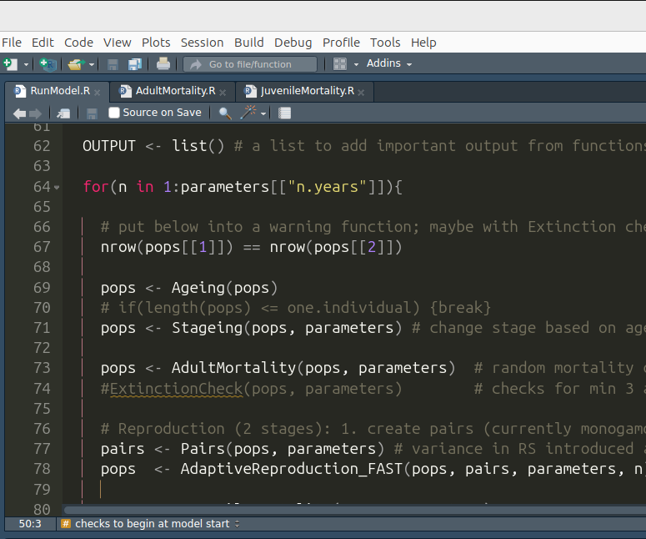
Create functions

Slide 30
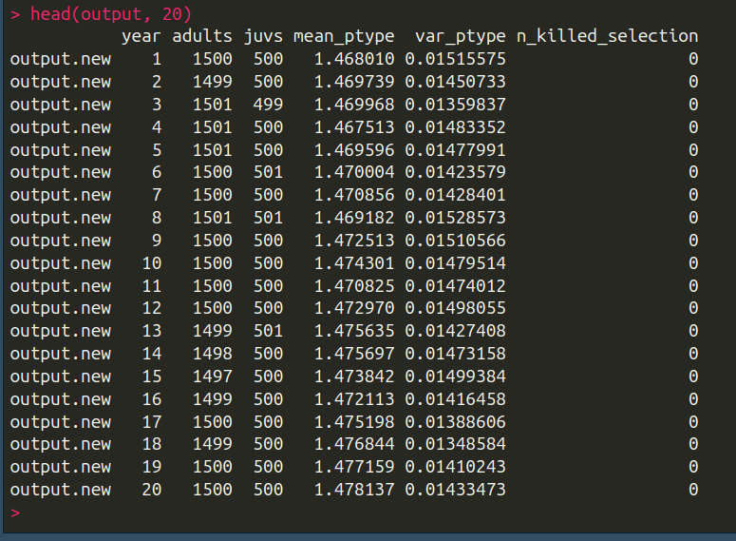
Create output

Slide 31
Advanced topics
Extinction
Bugs / build in checks
Version control (Git and Github)
Deploying the model
Optimizing the model
Packages/libraries
Data analysis
Natural behavior (Logistic equation vs. mortality)

Slide 32


Slide 33
Break 1
Feel free to stretch
Please return in ~ 10 minutes

Slide 34
Extinction
Will cause model to crash in R
Need control flow statements: https://adv-r.hadley.nz/control-flow.html

